Slide 1
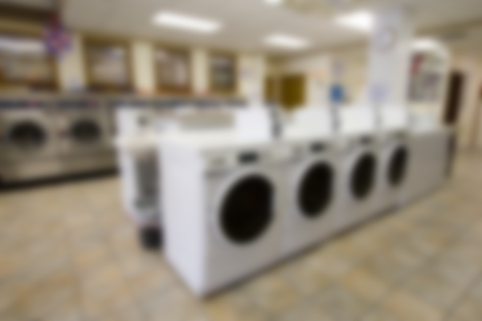
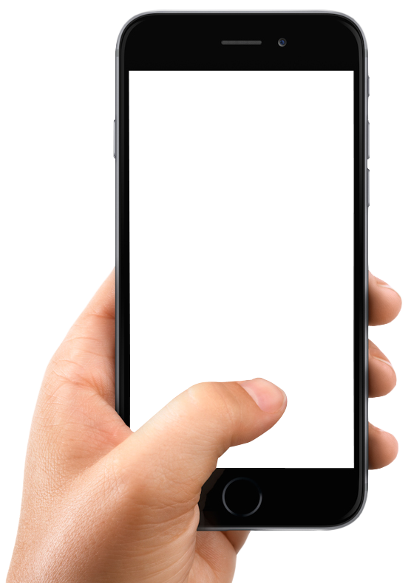

IOT BASED SMART LAUNDRY SYSTEM

Slide 2




Meet the team
ANCHIT PANDEY
Computer Science
FIFA’17 Champ
VRUSHALI PATIL
Electronics and Communication Engineering
Classical Dancer

Slide 3
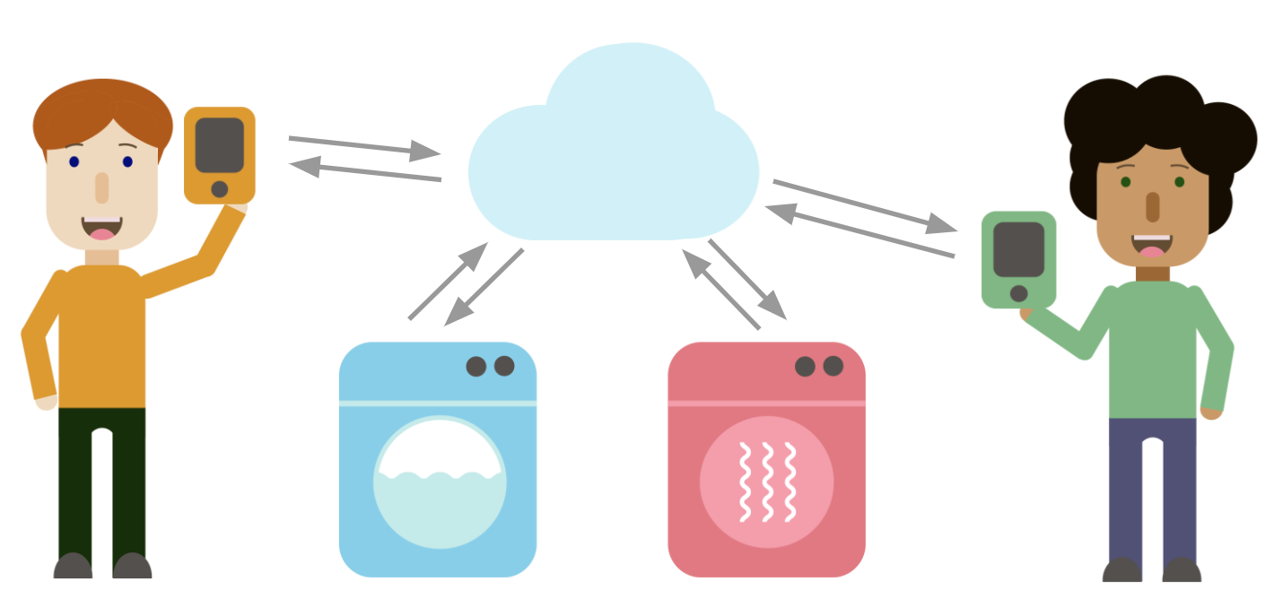
Our Solution in short
---
Control laundry machine via a mobile device
---
Hardware and Software Platform

Slide 4
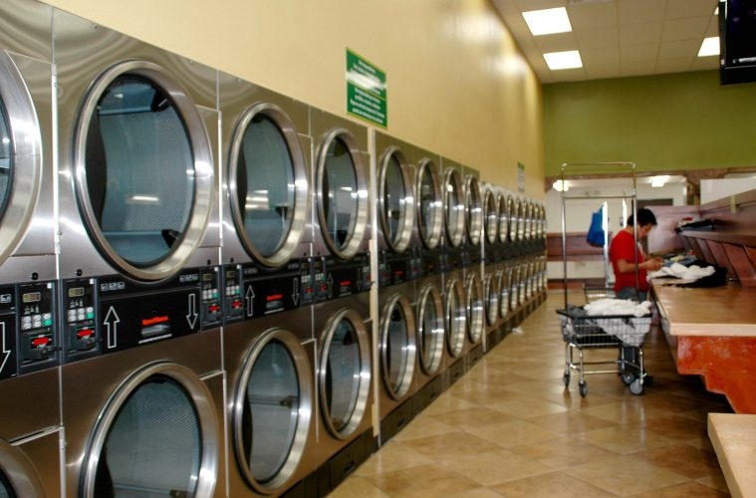
Self Service Laundromats
Student residences at universities
Apartment Blocks
Hospitals and Hotels

Slide 5
Current methods of operating a machine
….......
……...
Coin Operated
Card Operated

Slide 6

Drawbacks of the current system

Slide 7
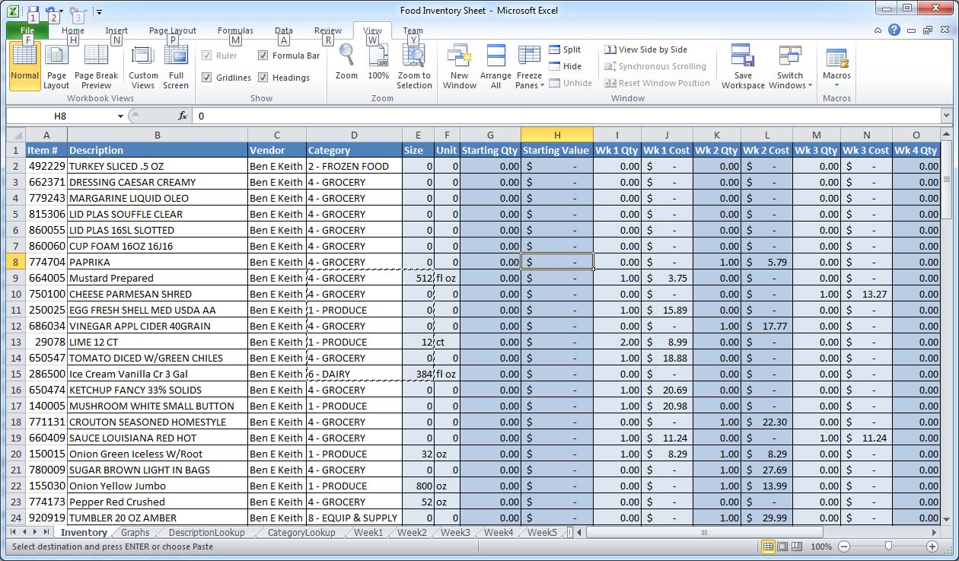

Book keeping issues
Lot of manual work
Poor utilisation of
manpower and resources

Slide 8
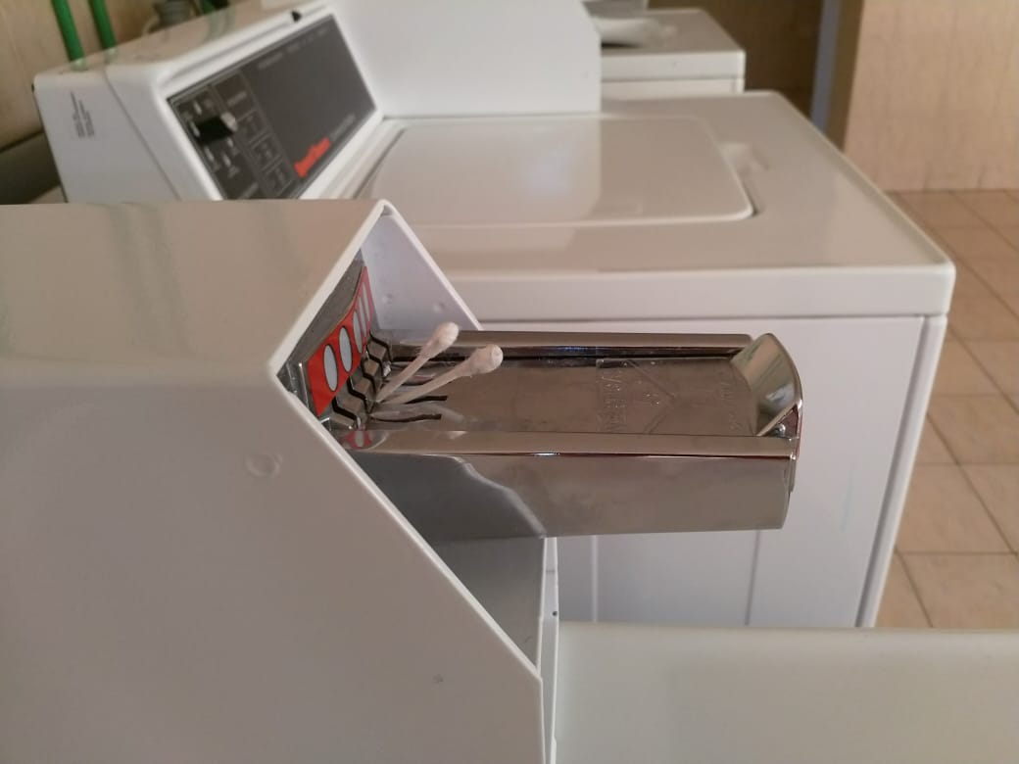
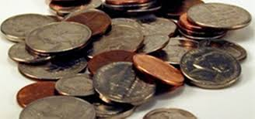
Less Secure: Fake/Bogus Coins and Earbuds used for operation
Collection and Recycling of coins

Slide 9
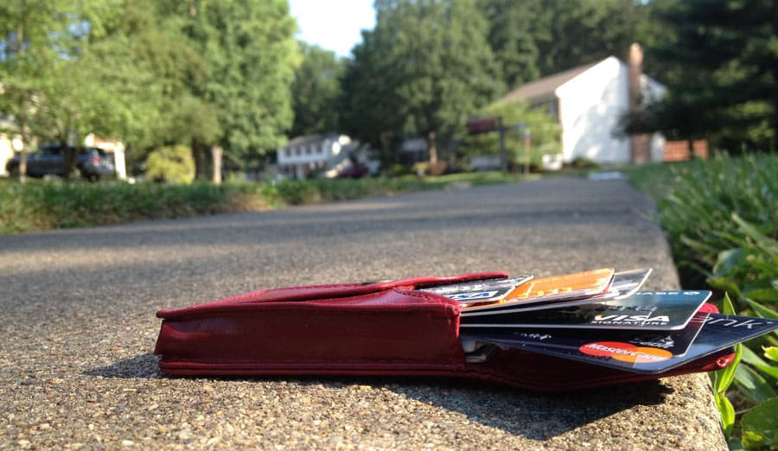
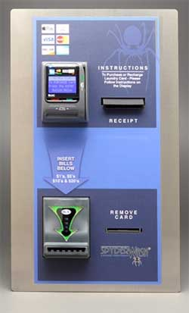
Expensive kiosk for card top-up
Loss of card
Substantial modification in hardware

Slide 10
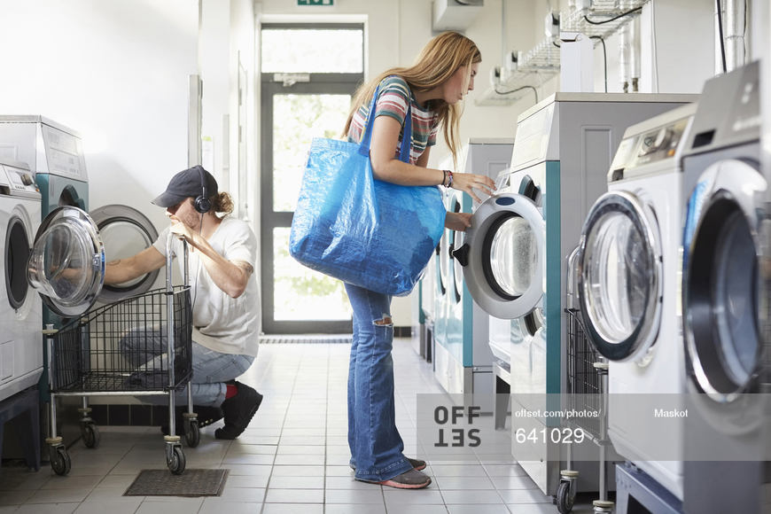
User has to periodically visit laundromat to check if the cycle is completed.

Slide 11
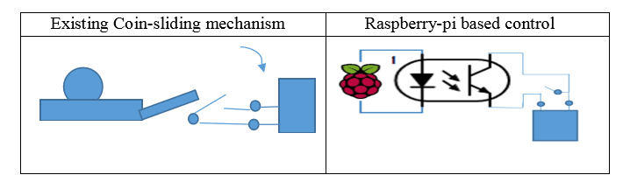
Comparison between the old and the new system
Lever
Machine
Optocoupler
Machine
Micro switch

Slide 12
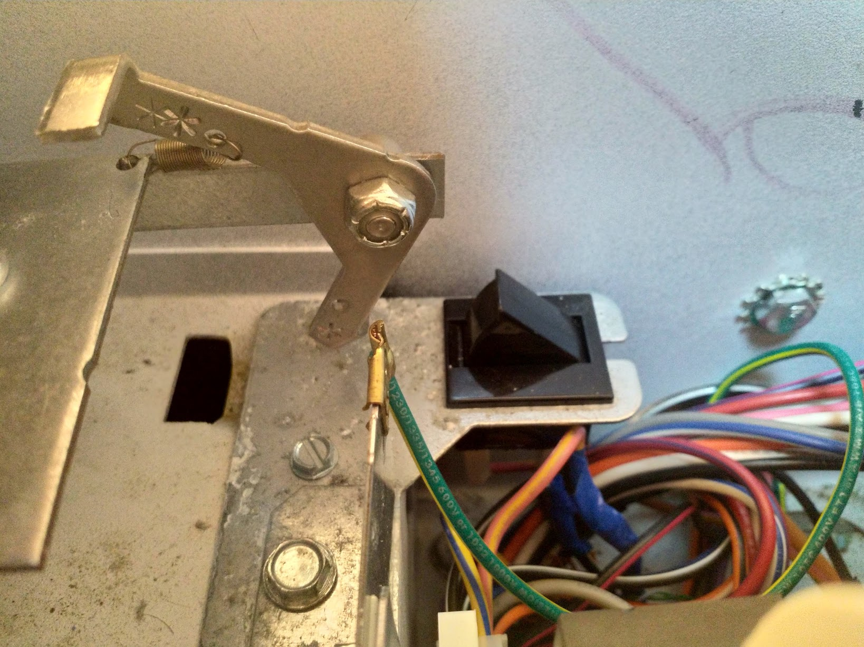
The Control Circuitry
Lever
Micro-Switch

Slide 13
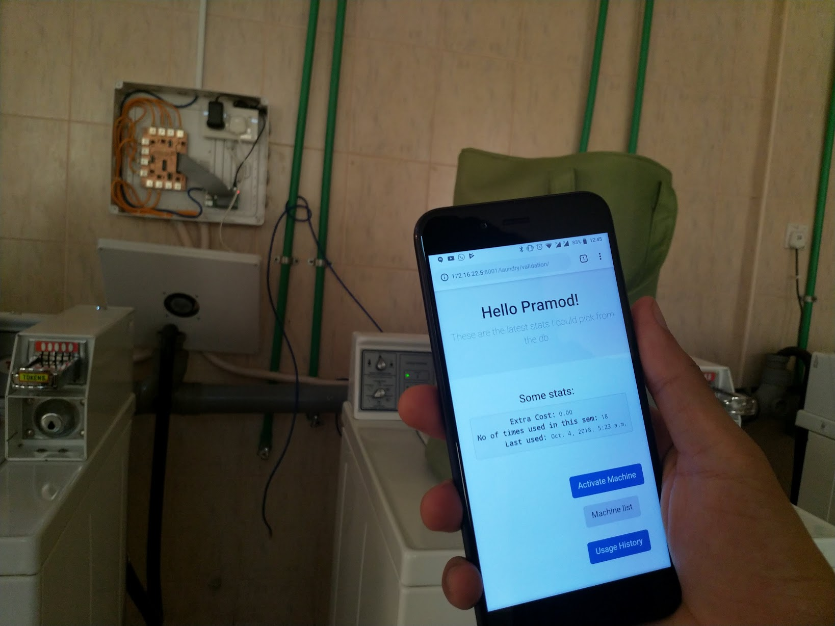
Our USP
PCB Board
Web App

Slide 14

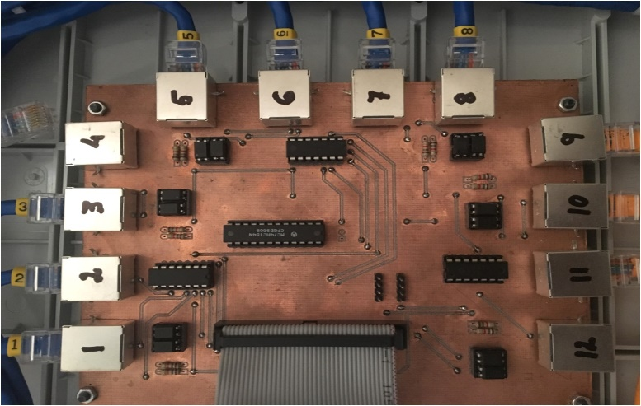
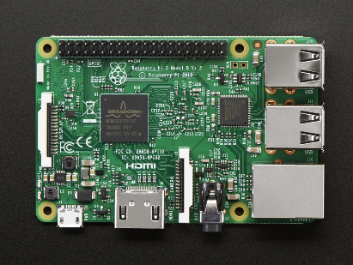

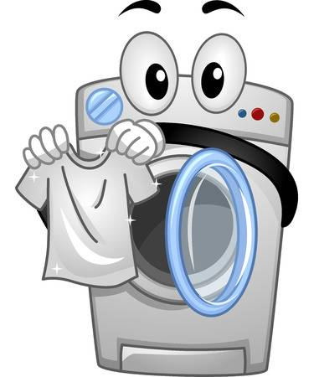
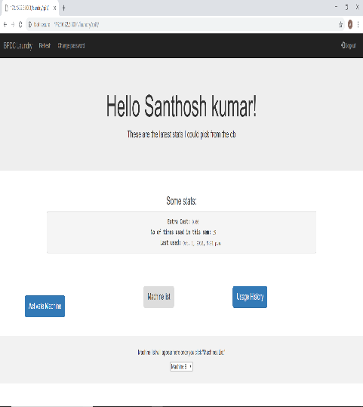
Raspberry Pi
Server
PCB
Web app
Machine

Slide 15

Working of the PCB Board

Slide 16
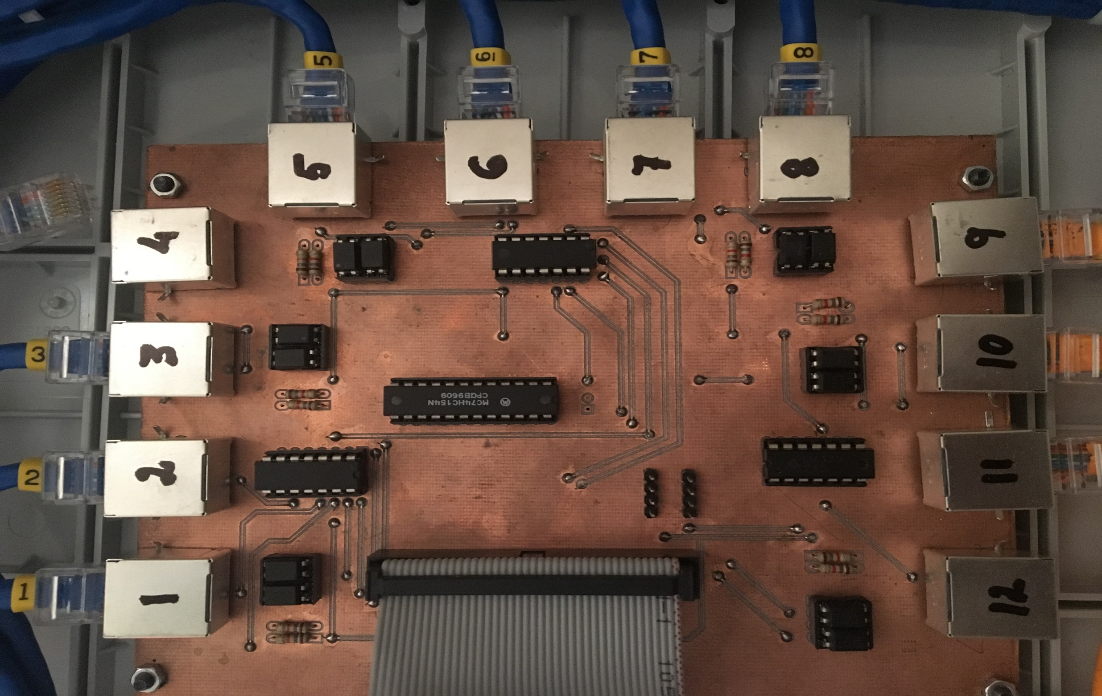
Ethernet Cable
RJ45 Port
Resistors
Optocoupler
Decoder
Comparator
40 Pin GPIO Header

Slide 17
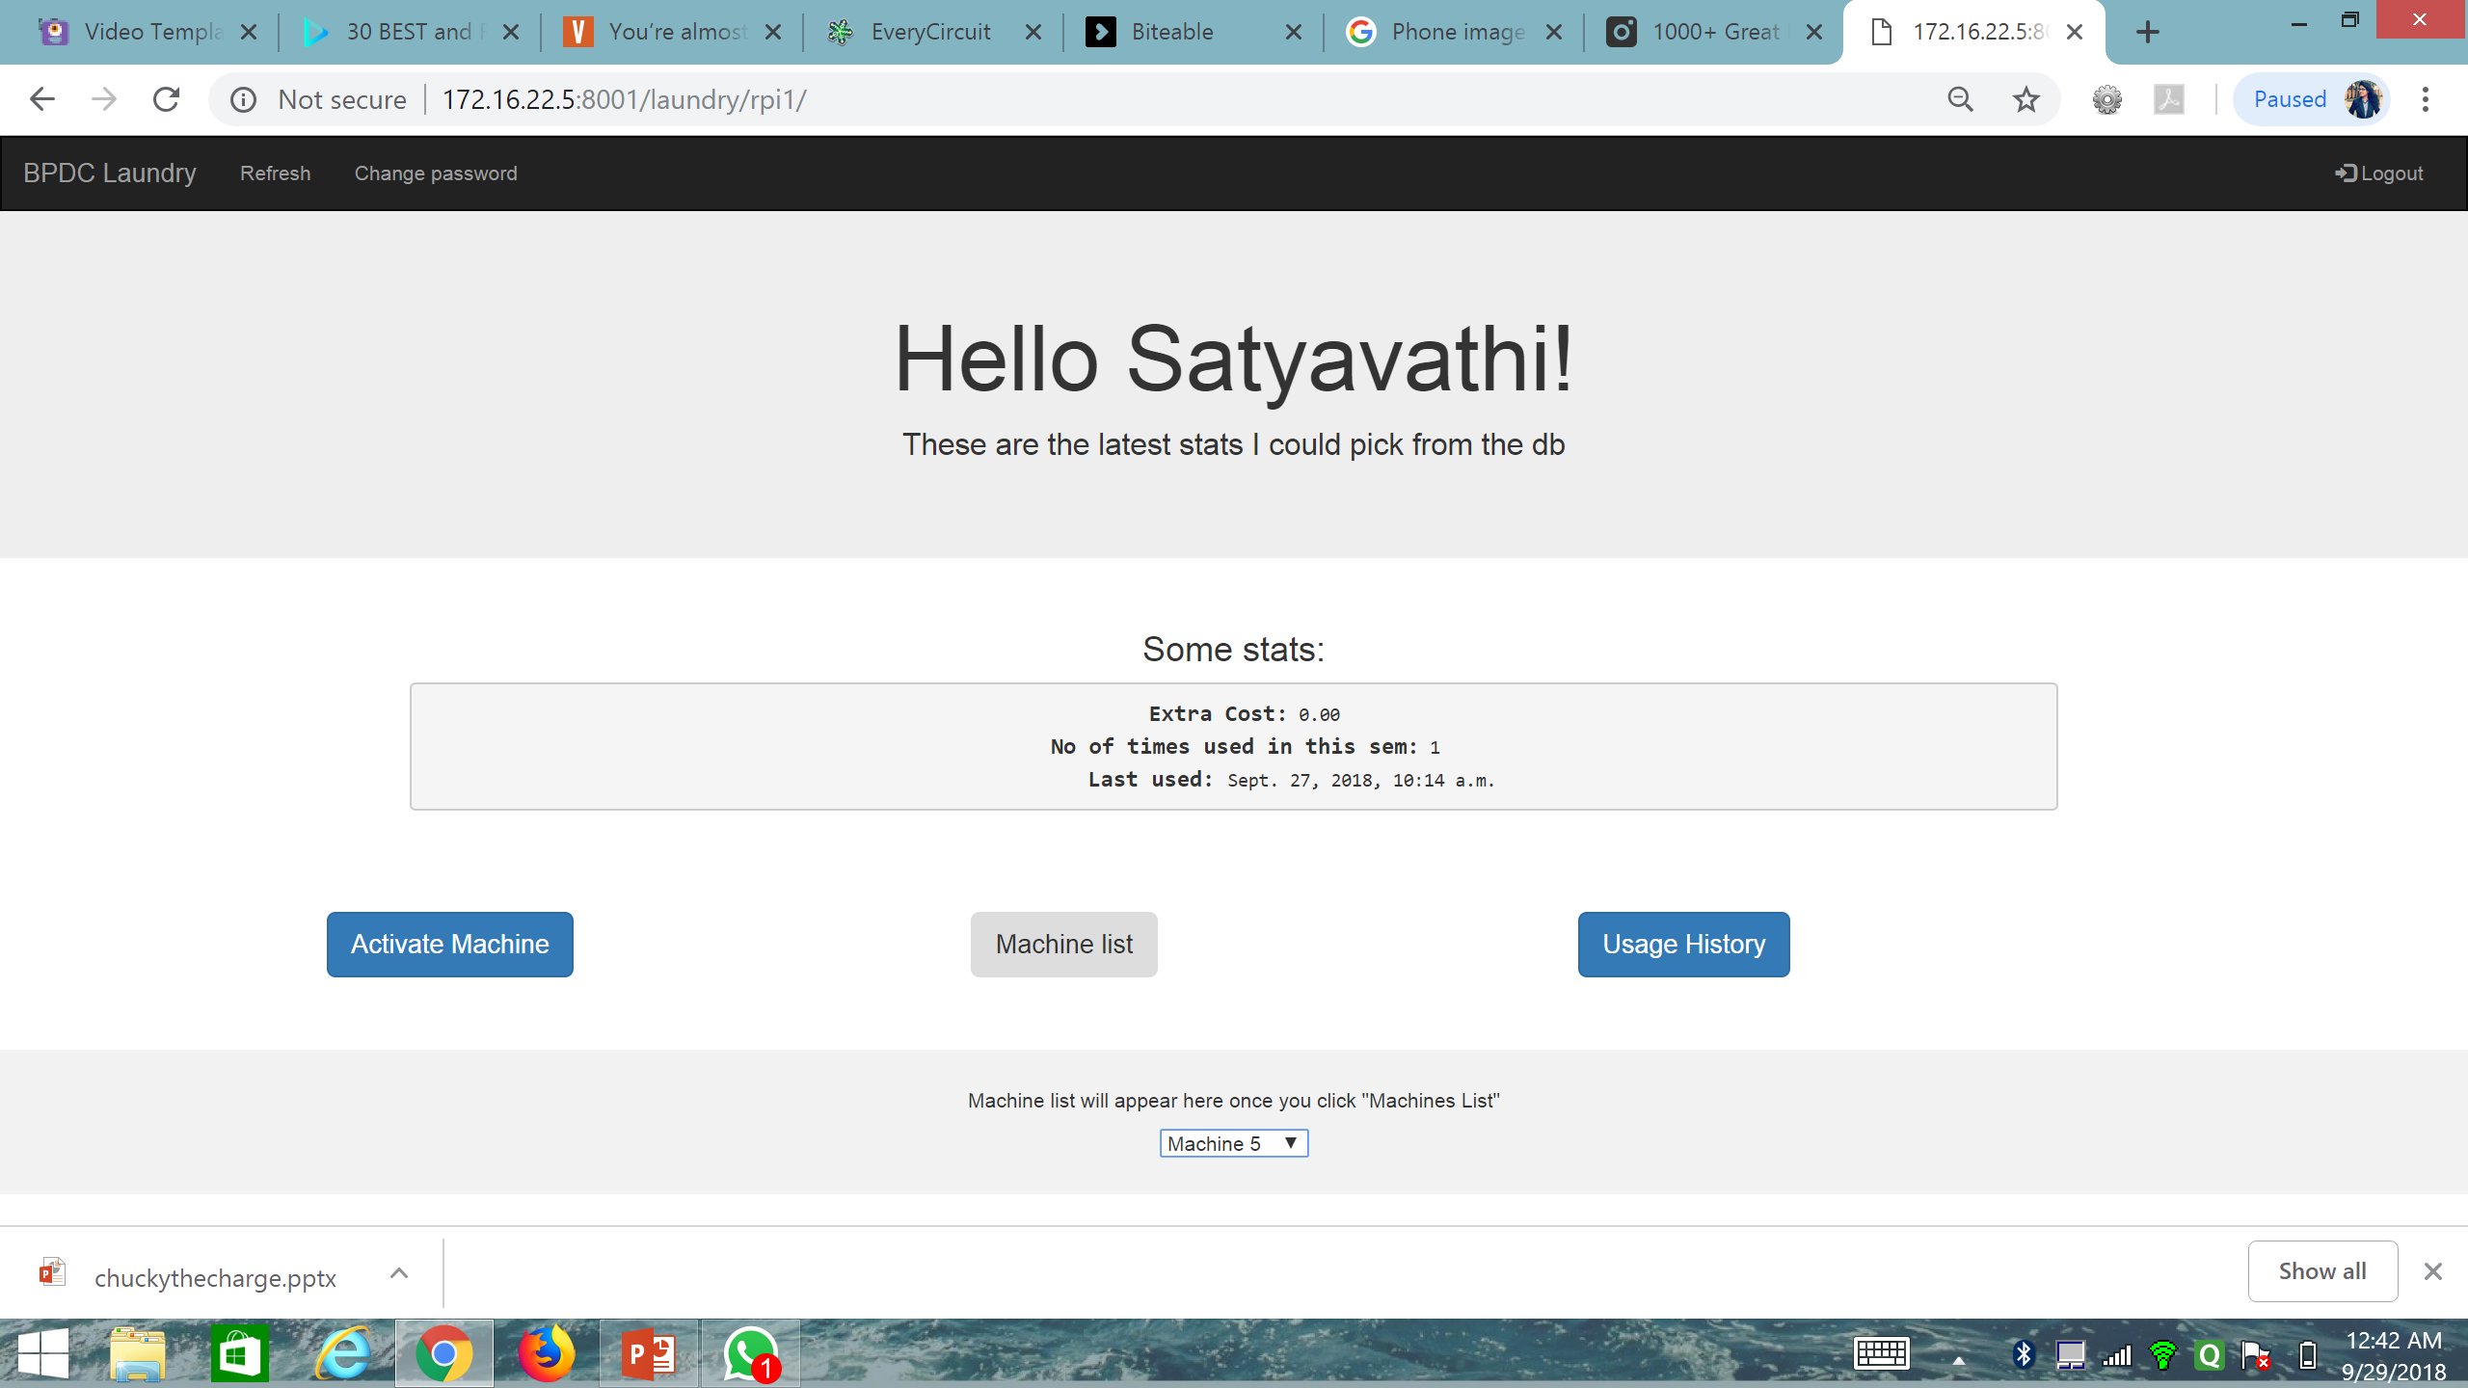
VIEW MACHINE LIST

Slide 18
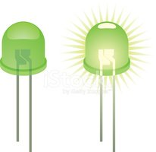
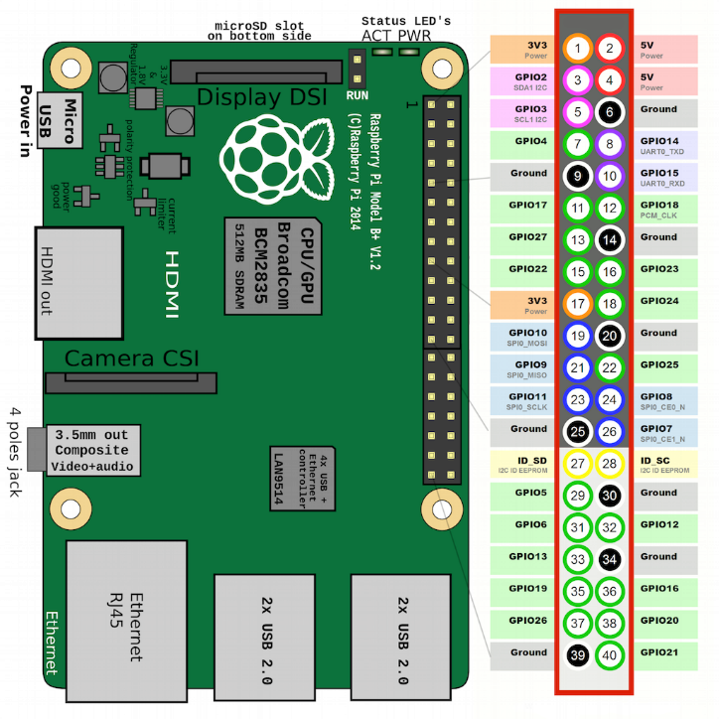
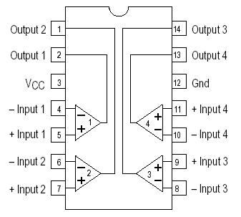
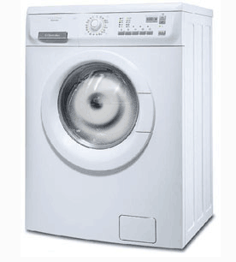
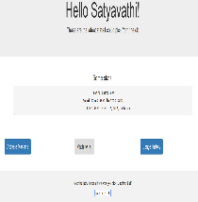
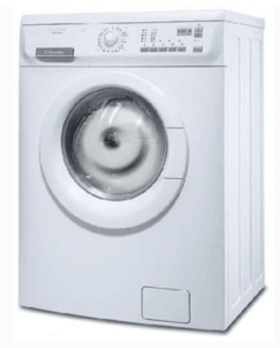
Machine 3 will not be displayed in ‘VIEW MACHINE’ list
3.3v > 0v
o/p = 0
Vref = 3.3V
0v
3.3v < 5v
o/p = 1
3
VIEW MACHINE LIST
5v
Vref = 3.3V
Machine 5 will be displayed in ‘VIEW MACHINE’ list
5

Slide 19
ACTIVATE MACHINE ‘5’

Slide 20
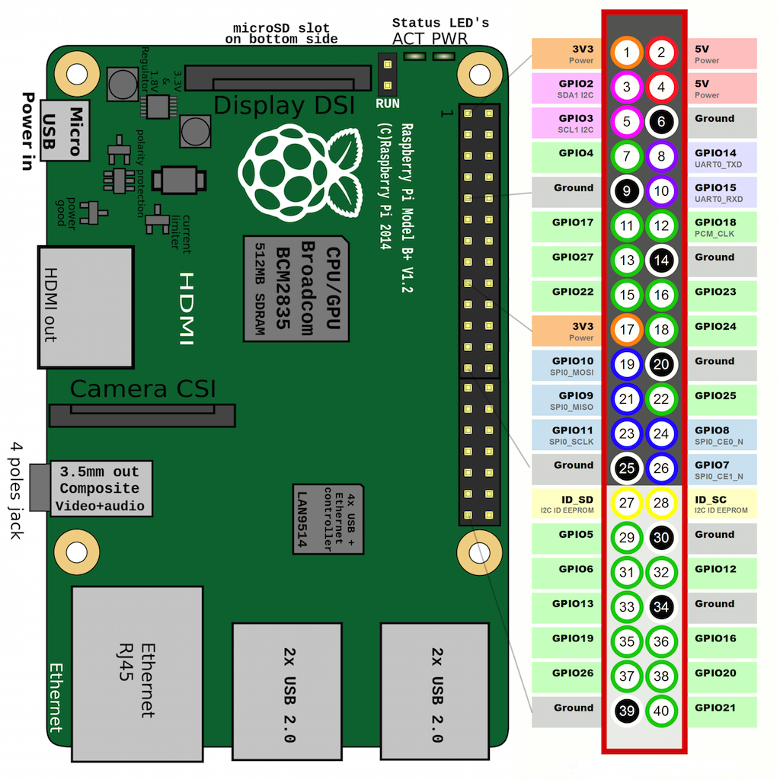
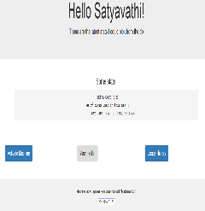
ACTIVATE MACHINE ‘5’
5 = 0101
0
1
0
1

Slide 21
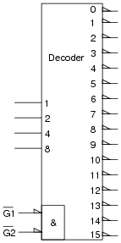
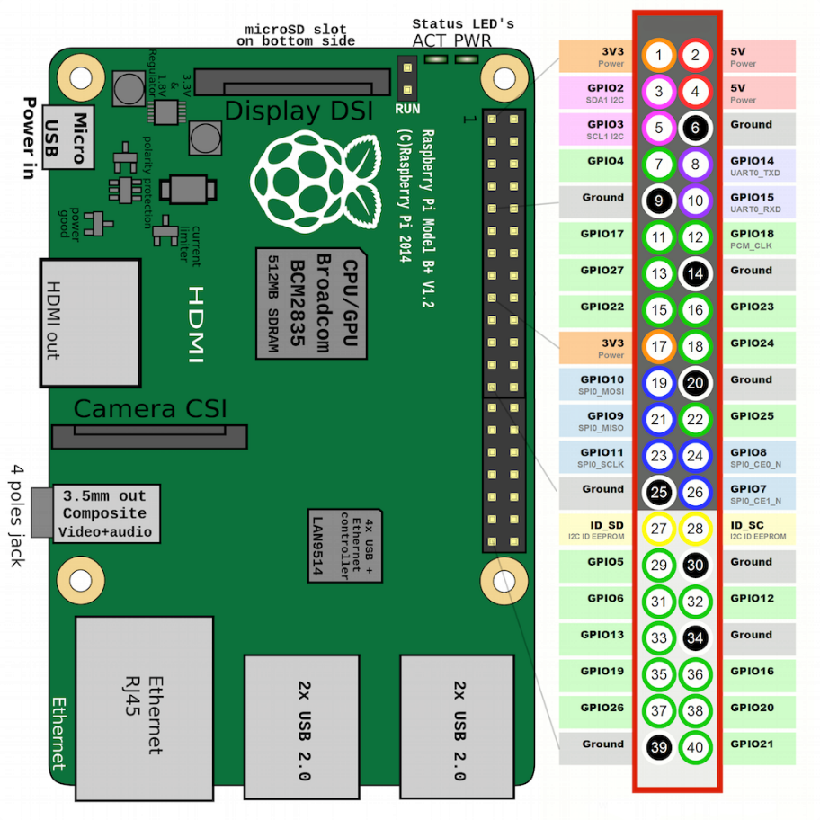


1
1
1
1
1
0
0
1
1
5 = 0101
0
1
ACTIVATE MACHINE ‘5’
1
1
1
1
1
1
1
1
1

Slide 22
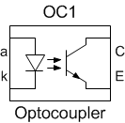

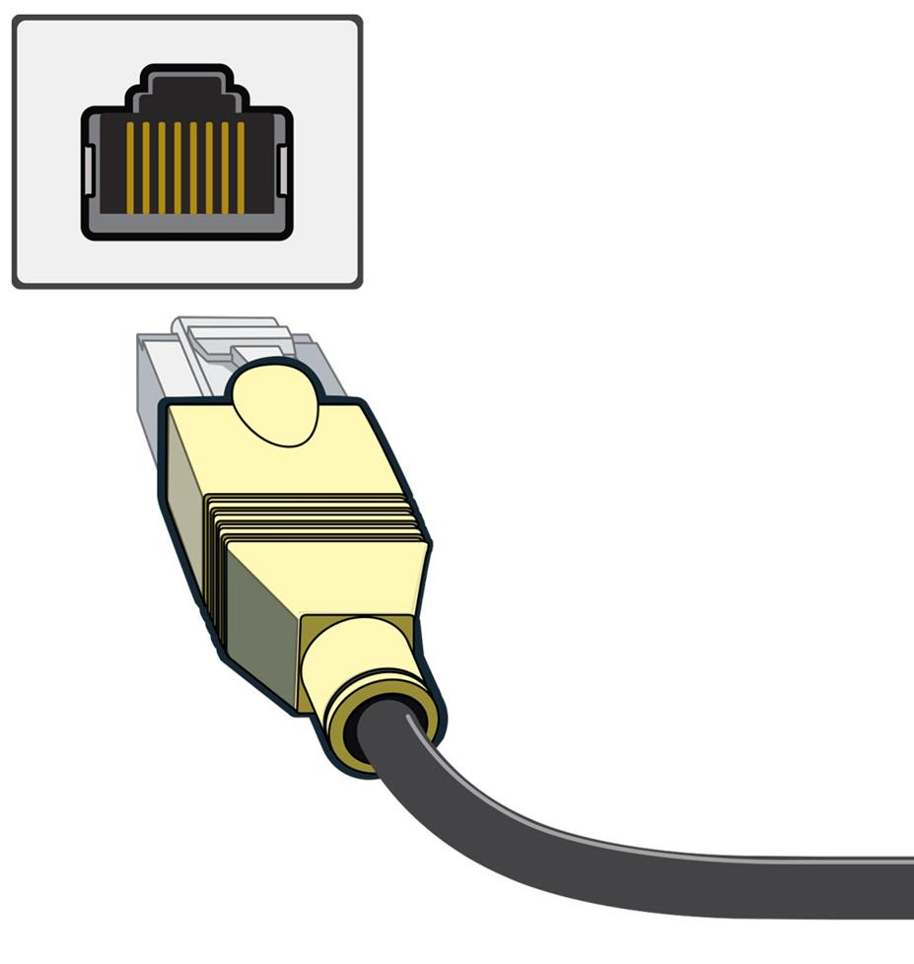
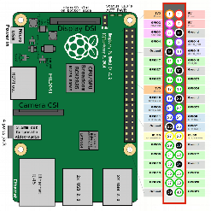
+Vcc
~
RJ45 Port
0
5 = 0101
0
ACTIVATE MACHINE ‘5’
1
1
0
Ethernet Cable

Slide 23

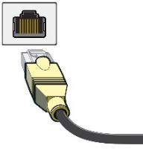
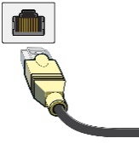


IN-USE LED ON
Inside The Machine
+Vcc
RJ45 Port
~
Micro-Switch Closed
Micro-Switch Open
5 = 0101
Ethernet Cable
0
ACTIVATE MACHINE ‘5’
0
1
1
0
RJ45 Port
The PCB BOARD

Slide 24

Working of the Web-App

Slide 25
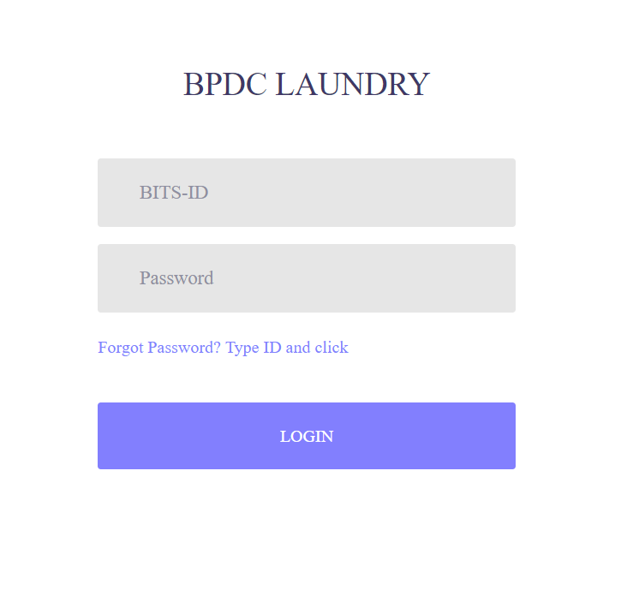
Login Page

Slide 26

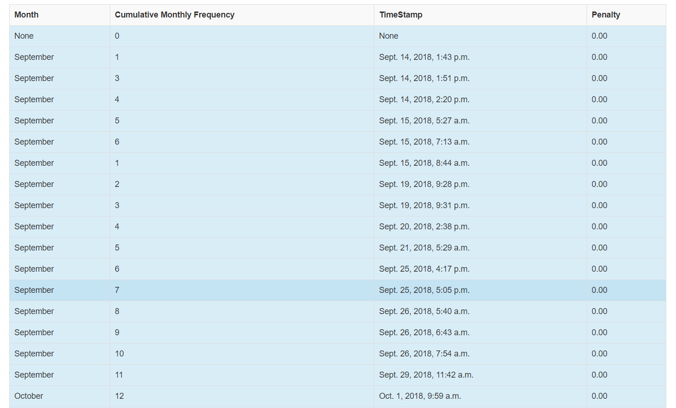
After logging in
Main Screen
Usage history

Slide 27
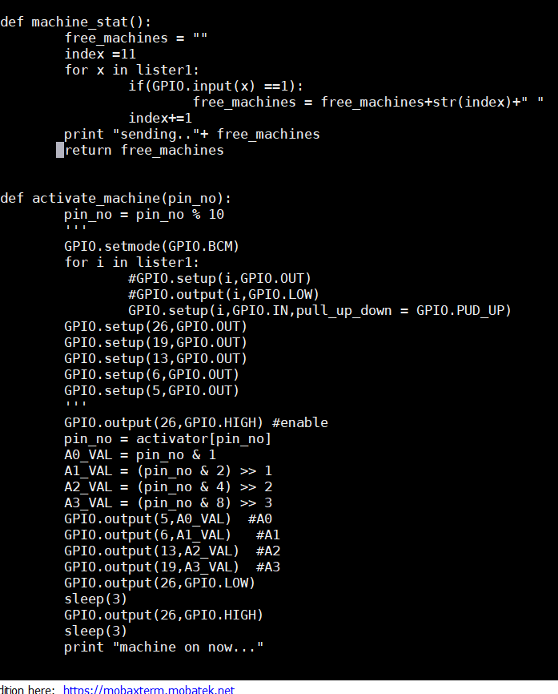
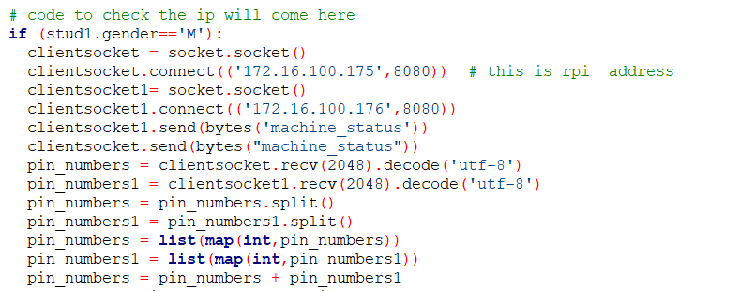
Client Side
Server Side

Slide 28
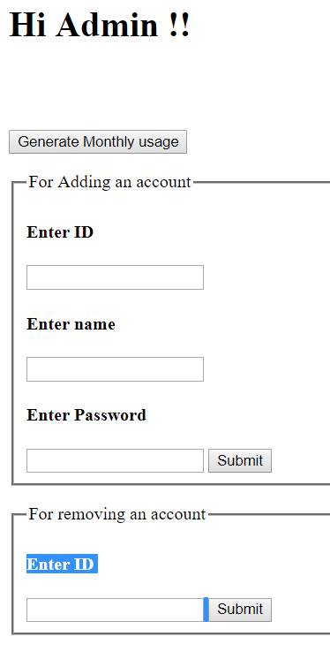
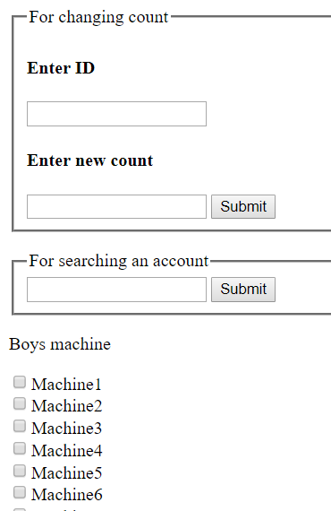
Admin Panel

Slide 29
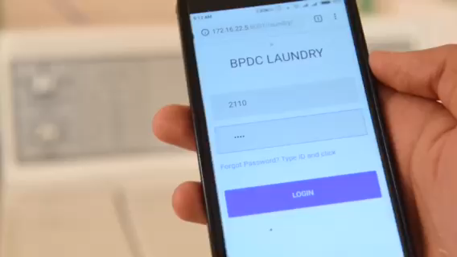

Slide 30
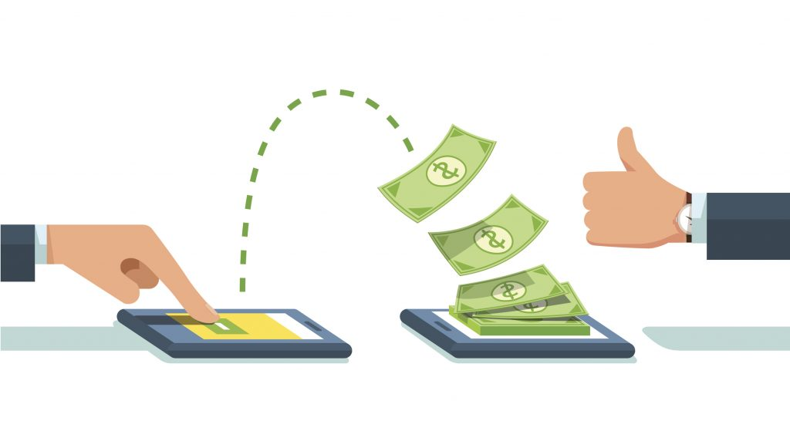
Payment options
For Universities
Linked directly to Students-ID and hence charges can be deducted from fees directly.
For Commercial Places
Laundromat has an account. User accounts can be topped up using digital payment option like PayTM.

Slide 31


Why Us?
User Friendly
Convenient for service providers
Robust and Secure
Scalable and Compatible

Slide 32
Technical Feasibility
Servers for app easily available
Raspberry pi for communication
Business Feasibility
Licensing the application
Patenting for cost reimbursement
Mass production
Easy manufacturing of customized PCB
Smooth and simple system installation
Minimal production cost

Slide 33
End User Value Addition
Preference
The most frequent users get a preference when there is long queue.
Free Activations
Free activations for customers
Points
Earn points

Slide 34

We believe such solutions will accelerate UAE’s mission of having the SMARTEST CITIES…..
Thank You

Slide 35
References
http://www.macgray.com/images/laundromats/cunninghams_laundromat_02.jpg
https://securecdn.pymnts.com/wp-content/uploads/2017/02/fiserv-financial-services-innovation-finserv-project-pymnts-biometric-security-speed-faster-data.jpg
https://us.123rf.com/450wm/lenm/lenm1603/lenm160300012/54948826-stock-illustration-mascot-illustration-of-a-washing-machine-handling-a-white-clean-shirt.jpg?ver=6
https://hapakenya.com/wp-content/uploads/2018/03/main-1-759x500.jpg
https://hapakenya.com/wp-content/uploads/2018/03/main-1-759x500.jpg
https://encrypted-tbn0.gstatic.com/images?q=tbn:ANd9GcS7xJ-0XsbukuNII7C10Sb83BIHg9E09HPzIdM_ardGrDDa7d5q
http://www.laundrycard.com/wp-content/uploads/2014/04/laundrycard-slider01.jpg
https://cdn-grid.fotosearch.com/CSP/CSP991/isolert-alarmere-trekant-signere-utklipp__k11656402.jpg
https://i.stack.imgur.com/7JoKT.jpg
http://echeck.org/wp-content/uploads/2016/10/lost-credit-cards.jpg

Slide 36
References contd…
https://upload.wikimedia.org/wikipedia/commons/thumb/c/c2/Breeze_vending_machine.jpg/220px-Breeze_vending_machine.jpg
https://cdn6.dissolve.com/p/D929_44_118/D929_44_118_1200.jpg
https://cdn6.dissolve.com/p/D929_44_118/D929_44_118_1200.jpg
https://vectortoons.com/wp-content/uploads/2015/09/in-bed-collection-tom-008.jpg
https://www.airliquide.com/sites/airliquide.com/files/styles/web_page_cover/public/2015/06/22/uae-banner.jpg?itok=xMeQ6tk_
https://img.clipartxtras.com/f3e4c7c89161f56774897fdb9454a5a8_database-server-clipart-web-server-clipart_652-800.png
https://i.stack.imgur.com/KBD5v.jpg
https://www.google.ae/url?sa=i&rct=j&q=&esrc=s&source=images&cd=&cad=rja&uact=8&ved=2ahUKEwikr_O5lvDdAhUMWhoKHbm-BVoQjRx6BAgBEAU&url=http%3A%2F%2Fkrakencraft.co%2Fraspberry-pi-gpio-diagram.html&psig=AOvVaw2UqxcqH0FvmjDuQVQINswe&ust=1538858942688431
https://i2.wp.com/mytaxguyinhouston.com/wp-content/uploads/2017/06/shutterstock_122932270.jpg?fit=1000%2C667&ssl=1
https://cdn.globalxfunds.com/content/files/IoT.jpg

